Slide 1




Conversation1 : Calling up Contact Center to apply for a Loan

Slide 2
Conversation1 : Calling up Contact Center to apply for a Loan
Transcript
good morning sir i may all be today i would like to apply for alone please very good at what kind of lonely looking for i wanna loan to buy new hall and how much were you hoping to apply for today i was opened and i can apply for two hundred fifty thousand dollar whole lot first we set this eat your credit is good enough for alone that large i have a great score of seven hundred sixty excellent and also see on your credit report that you've always paid on time yes i know how hornet is to pay your debts and paid him one time we do be making it down payment on a new house i have ten thousand dollars available for a down payment an outlet to finance the rest i have just a few more questions for the application what is your gross monthly income i make seven hundred fifty dollars a week so i suppose my average monthly income would be about three thousand how long would you like the life of the loan to be one of my options you can choose between a ten fifteen twenty or thirty year long what's the difference between a fifteen year loan n. a thirty year long fifteen year loan mean higher monthly payments but he will pay less interest so a thirty year long will mean lower monthly payments but i'll end up paying more in the long run that's right which would you prefer i think of a rather pay off sooner cannot pay is much interest in we will sign you up for fifteen year loan with my interest rate based on your credit report an excellent credit score your interest rate will be five point nine percent that's great where do i sign just fill out this remaining paperwork and will get you into your new home

Slide 3
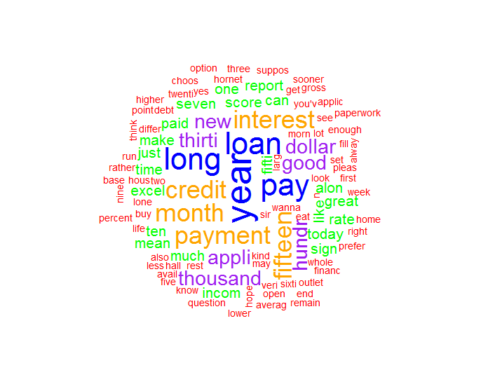
Conversation1 : Calling up Contact Center to apply for a Loan
Wordcloud Visualization

Slide 4
Conversation2 : Calling up Contact Center to query for Credit Card statement

Slide 5
Conversation2 : Calling up Contact Center to query for Credit Card statement
Transcript
city bank cards good afternoon oh my name is jesus do or those years you're you're talking to friends how can i help you i didn't receive my credit card statement can you help me out of this okay on major credit card number so access your town sure he's for three to three five seven six or six thirty five or six nine one two or i also he asked you a couple of verification question yes no rob what's the month of your birth january in your mother's first name it helen perfect view was sent to you and our regular mail i need as soon as possible so squeezed malice and he sure your credit cards to resent you within twenty four hours is there anything else in a healthy way no thank you hi paul how're you on the issues and a huge stressed out what happened when i'm just to see my final crackers do guys is only i don't know all your head all you should use the carefully jason how much is it almost three thousand dollars gee that's too much indeed i know but it wasn't me he was my wife she uses all law which you travel well it seems you wanna revisions would arise i'll tell me about anywhere else on this ruined and i can see what can we go on the lot man you'll need a higher minimum minority i'm taking a look great shoelace guy you paying in cash as usual mr jackson actually he has a my credit card is sure no problem i'm rather is is a big bang shoot us are many i would do we accept credit cards for all leading banks in the states and abroad in that case i'm sure i see that one will do that right absolutely higher i wanna use my credit card on line can you how we are not sure jason when you quit the credit card cannot sing us your forecast israel credit card information tighter credit card number and see the numbers are aware though was the cd in our faces reduce the number you can imagine your car for the car and you'll see yet i got when you fill the information your brand new senate confirmation code yourself all usenet go to authorize the pain of our banks along and i'm sure our messes up the entire trial by alone and let you know i wanna use my credit card on line i didn't receive my credit card statement can you help me out of this your credit cards to resent you within twenty four hours on major credit card number that masses your town we accept credit cards for all leading banks in the states and abroad

Slide 6
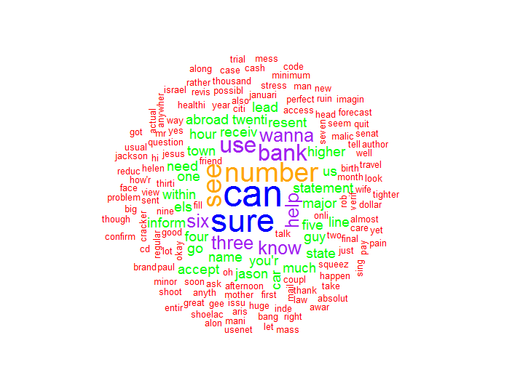
Conversation2 : Calling up Contact Center to query for Credit Card statement
Wordcloud Visualization

